Slide 1


Microsoft Excel 2007 Introduction to Spreadsheet Programs
Workshop: Spreadsheet
Nov. 06, 2016
P. K. Yadav & C. Gupta
Presentation 1
Notes:
<number>

Slide 2
Introduction to Excel Objectives
Objectives
After completing this lesson, you will be able to:
Identify the components of a spreadsheet.
Enter data into a spreadsheet.
Perform basic mathematical tasks in a spreadsheet.
Insert charts in a spreadsheet.
Printing a spreadsheet.
Notes:
<number>

Slide 3
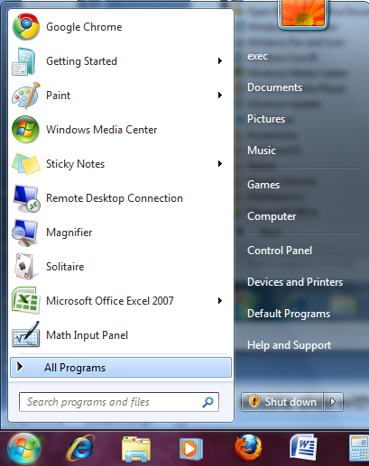

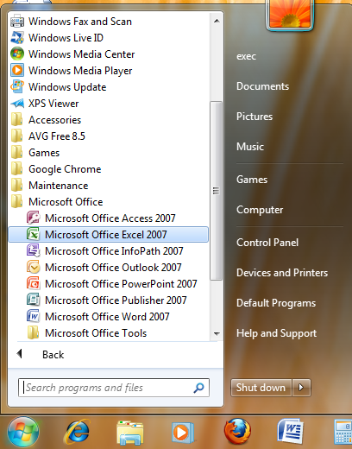
GETTING STARTED
To open Excel, click the Start button, point to All Programs, point to Microsoft Office, and then click Microsoft Office Excel 2007.
Notes:
<number>
Explain to students that sometimes they have the icon on their desktop already and that by double clicking they can instantly open up the program.

Slide 4
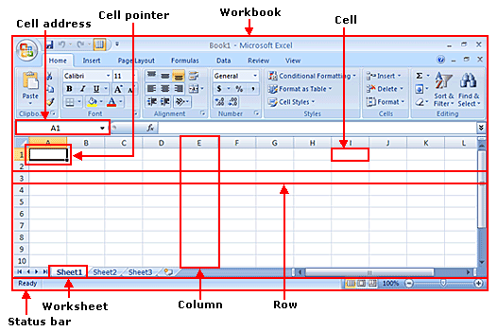

Overview of Spreadsheet Programs
Notes:
The interface of Excel 2007 includes the following parts:
Workbook and worksheets. A workbook is a file created in Excel 2007. A workbook can contain one or more worksheets and related items. An Excel 2007 workbook contains three worksheets. A worksheet is a single spreadsheet in a workbook. You can add or delete worksheets in a workbook as required.
Rows and columns. The horizontal divisions in a worksheet are called rows. Each row is identified by a number. For example, the first row in a worksheet is 1. Columns are the vertical divisions in a worksheet. Each column is identified by a letter. For example, the first column in a worksheet is A.
Cell. A cell is formed by the intersection of a row and a column. The highlighted rectangular border formed around an active cell is called a cell pointer. An active cell is the cell in which you are working currently. There can be only one active cell at a time. You can use a cell to store and display different types of data such as text, numbers, or formulas. Each cell in a worksheet is identified by a cell address. A cell address is made of the column letter and row number of the cell. For example, the cell formed by the first column and first row has the cell address A1. The cell address indicates the exact location of a cell in a worksheet.
Status bar. This bar provides information about the present status of work in the worksheet. For example, if you are not working on the worksheet, the status bar displays the message “Ready.” When you click in a blank cell to enter data, the status bar displays the message “Enter.”
<number>

Slide 5
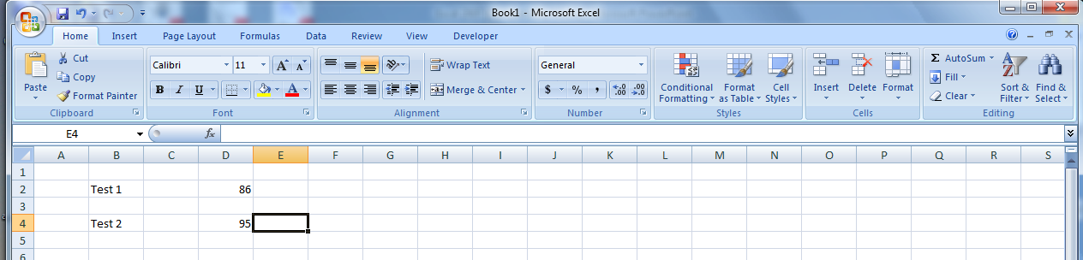
Working in a Spreadsheet
To work with a spreadsheet, you enter data in the cells of the spreadsheet.
You enter data by clicking a cell and typing the data.
To replace data in a cell, you click the specific cell and type the new data.
To edit data in a cell, you double click in the cell and type additional data.
Note: when editing data, a blinking cursor appears.
Notes:
<number>
Explain to students WHY WE USE EXCEL, give them an example such as keeping a ledger of their expenses.

Slide 6
Working in a spreadsheet (cont.)
You can enter three types of data in a spreadsheet:
Text: Text data has no numeric value associated with it.
Numbers: A number has a constant numeric value, such as the test scores attained by a student.
Formulas and functions: Formulas and functions are mathematical equations.
Notes:
<number>

Slide 7
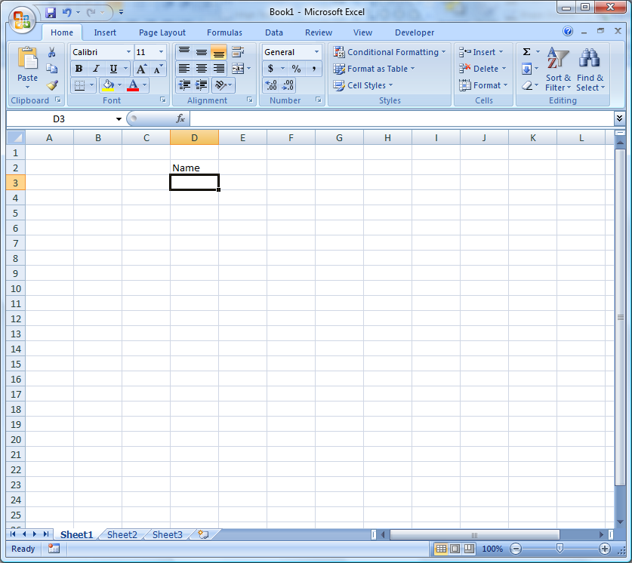
Enter Data
To ENTER data:
click on the cell
type information
press ENTER.
The data can be both number and text.
Notes:
<number>

Slide 8
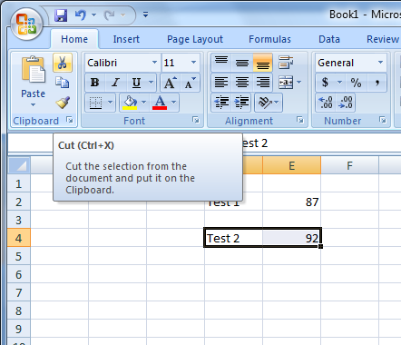
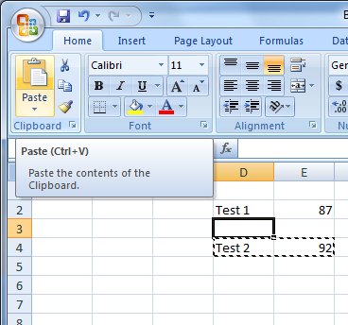
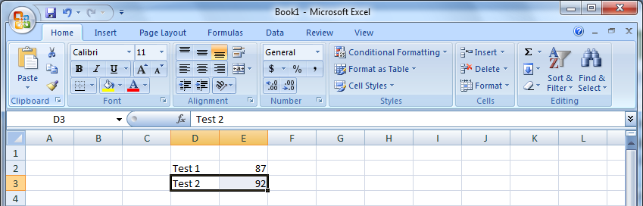
Cutting & Pasting data
Notes:
<number>
To move the contents from one cell to another cell, click on the first cell, click the Edit menu, and then click Cut.
Then select the new cell by clicking it and then , click the Edit menu, and then click Paste SHORTCUT: After selecting or clicking on The cell, click on Cut Icon (Scissors) on the Standard Tool Bar.

Slide 9
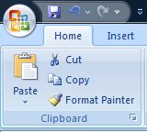
Cutting & Pasting data (cont.)
To COPY contents of a cell:
Click on the cell,
Select the Home tab,
Click Copy from the Clipboard Group.
To PASTE contents of a cell:
click on the cell,
Select the Home tab,
click Paste from the Clipboard Group.
Notes:
<number>
Remember to show them that they can also use this tool bar to cut, save, print, open, save their information

Slide 10
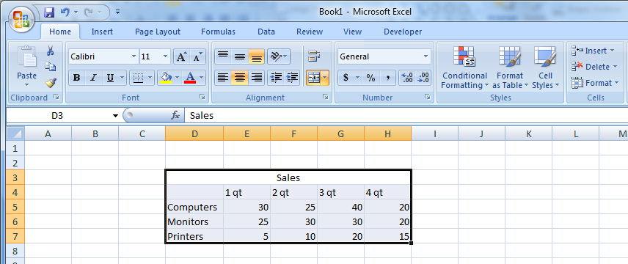
Selecting cells
To select a range of cells in a column/row, click the left mouse button in a cell & drag the mouse pointer to highlight the cells of your choice.
Notes:
<number>
Now Explain to students why you select cells. For example: B3-D3 the font is smaller than A3, we are selecting these columns by left clicking and dragging the mouse and then changing the size on the formatting tool bar. **To copy cells vertically or horizontally you can click the first cell that you want, press shift, hold down the shift, and then click the last cell you want to select in a row or column

Slide 11
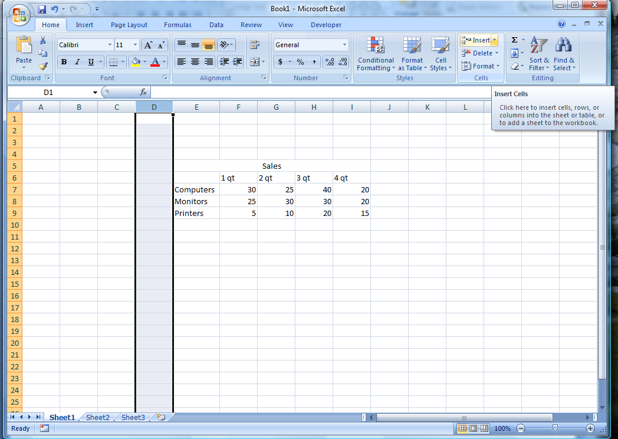
Adding rows & columns
To INSERT a Row/Column:
Select the row/column heading,
Click the Home Tab,
Click the Insert button from the Cells Group.
The insertion occurs before the selected column/row.
Notes:
<number>
To Insert a Row or Column to your spreadsheet select the row or column where you would like to add one and then click the Insert menu, and then click Rows or Columns, whichever one you’d like to add. NOTICE ON THE FIRST SLIDE “NAME” IS ON ROW 3 BUT AFTER ADDING A ROW IT IS NOW ON ROW “4”

Slide 12
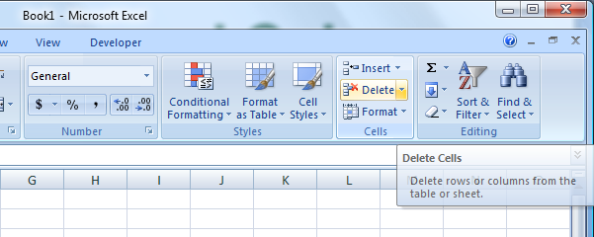
Deleting Rows and Columns
To delete a column/row:
click the column/row heading
click the Delete button on the Cells Group of the Home Ribbon.
Notes:
<number>

Slide 13

Finding the right size
You can expand the width of a column or the height of the row to increase the visible space in each cell.
To begin changing the width of the column , move the mouse pointer over the right edge of column heading until the mouse pointer changes to a double-headed arrow.
Notes:
<number>
To change the width of the column I, drag the double-headed arrow to the right until the indicated box reads Width: 8.00 (61 pixels). To increase the height of a row, position the mouse pointer over the lower edge of row heading 16 until a double-headed arrow appears, and then drag it down until the box reads Height: 51.00 (68 pixels).

Slide 14
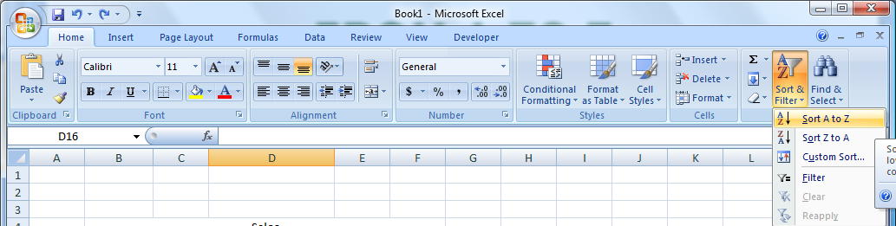

From a to z
You may want to organize or rearrange data in your worksheet. To sort data in the worksheet, click the column heading and then click Sort & Filter in the Editing Group on the Home Tab.
Notes:
Explain that you can also arrange the data that you enter in a spreadsheet. For example, you can sort the test scores attained by students in ascending or descending order to find the top scorers in a class. Similarly, you can sort the names of the students alphabetically.
<number>

Slide 15
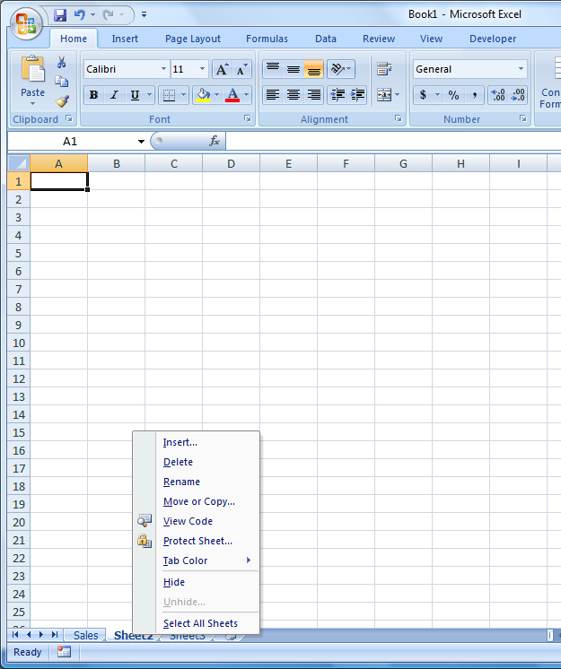
Editing spreadsheets
To rename a worksheet:
double-click the sheet tab
type the new name
press ENTER
You can also Delete & Insert a Worksheet as well.
Notes:
There are two ways to rename a worksheet tab. One is indicated in the slide. Another way is to right click on the worksheet tab and select Rename.
Have the students insert and delete worksheets.
There are two ways of inserting a worksheet tab: 1) Right click on the sheet tab, click Insert, select Worksheet, click OK; 2) On the Home Ribbon from the Cells Group, click on Insert then click Insert Sheet.
To delete a worksheet tab: Right click on the worksheet tab and click Delete.
<number>

Slide 16
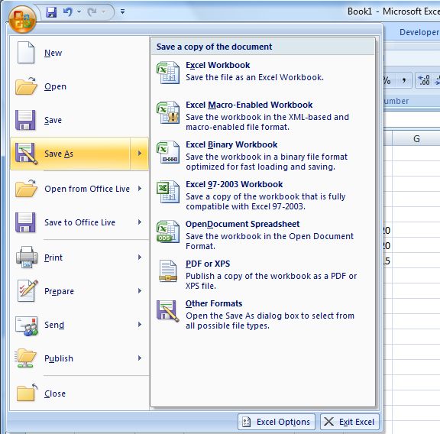
Save your work
To save a workbook, click the Office button, click Save As and choose how do you want to save.
Notes:
<number>
REMIND PATRONS ON HOW IMPORTANT IT IS TO SAVE THEIR WORK (constantly).
For beginners, it is best to save it in the default file format (Excel Workbook).

Slide 17
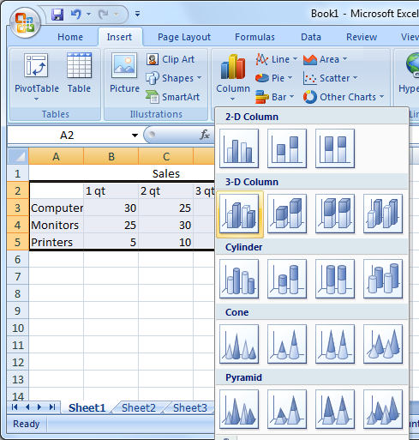
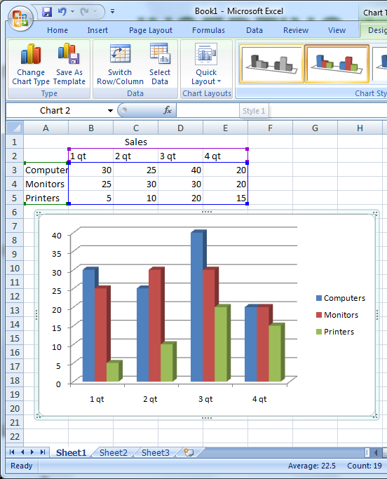
Inserting a chart
Notes:
<number>
YOU CAN ALSO CHANGE THE POSITION OF THE CHART BY SELECTING IT AND DRAGGING IT TO THE DESIRED LOCATION (POSITION)
Select Chart from the Illustrations Group of the Insert Ribbon.

Slide 18

Performing mathematical tasks
Notes:
<number>

Slide 19

Formulas & functions
Excel reads any expression that begins with an equal sign as a calculation. All functions and formulas begin with an equal sign.
The function =SUM(B1:B6)
The formula =B1+B2+B3+B4+B5+B6
Notes:
<number>
Excel reads any expression that begins with an equal sign as a calculation. All functions and formulas begin with an equal sign.

Slide 20
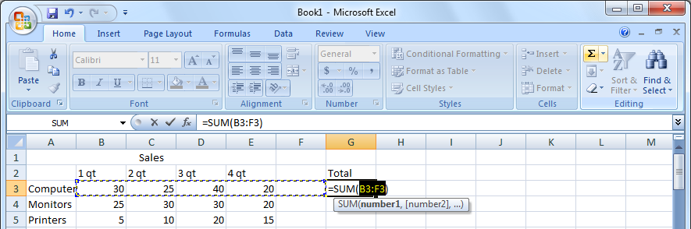
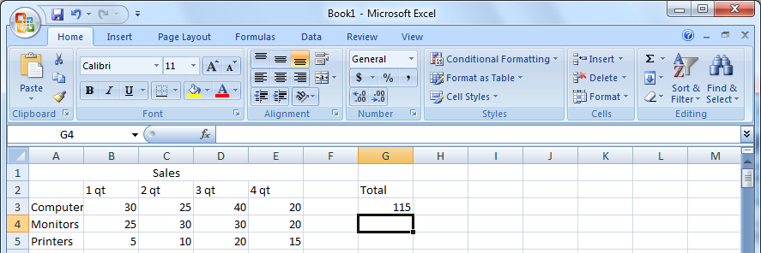
Formulas & Functions
Notes:
<number>
To Calculate the Sum of cells , click the destination cell, select the SUM button (sigma symbol), select cells for which you want to calculate the sum, drag the mouse pointer from cell C3 to cell C6, and then press ENTER.

Slide 21
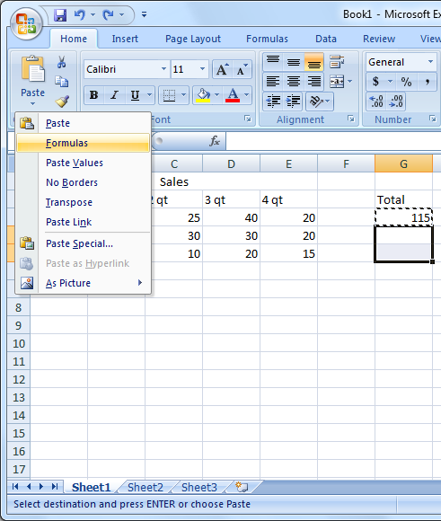
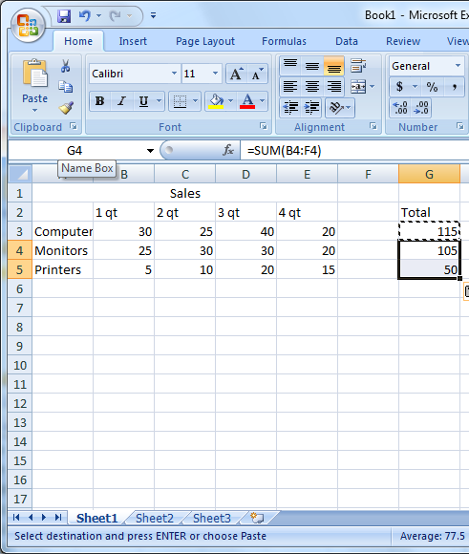
Copy & Paste formulas
Notes:
<number>
You can copy the same formula to obtain the sum of values in the cell range D3 to D7. To copy a formula from a cell to the Clipboard, click cell C9, click the Edit menu, and then click Copy. To paste the formula from the Clipboard to another cell, click cell D9, click the Edit menu, and then click Paste.

Slide 22
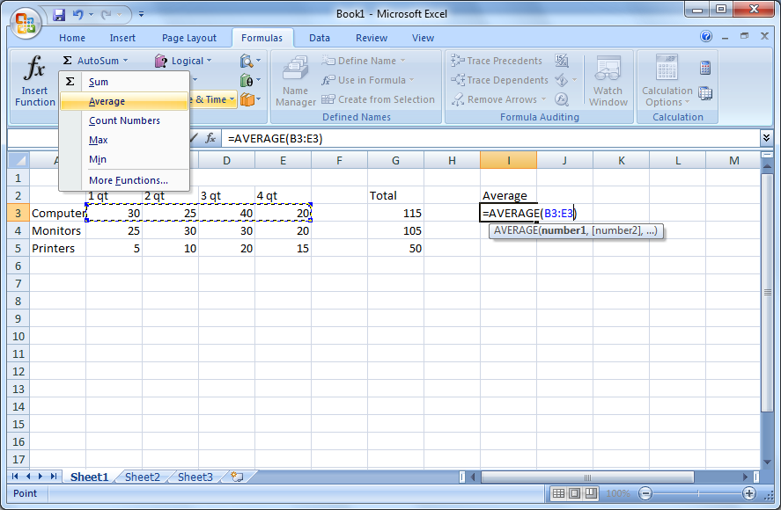
Inserting a function
Notes:
<number>
(1) Excel also provides a list of predefined formulas called functions. To insert a function to calculate the average of a group of values, click the Insert menu, and then click Function (2)To specify which cells should be used to calculate the average, in the Function Arguments dialog box, press SPACEBAR to have the cell range typed for you in the Number1 box, and then click OK. (3.) To save time, you can use the AutoSum button to perform functions such as sum and average

Slide 23
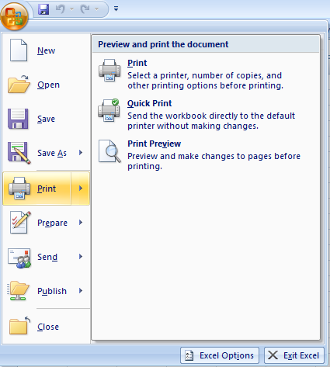
How to Print Spreadsheet Data
To print a spreadsheet, click the Microsoft Office Button, point to Print, and then click Print.
Notes:
<number>

Slide 24
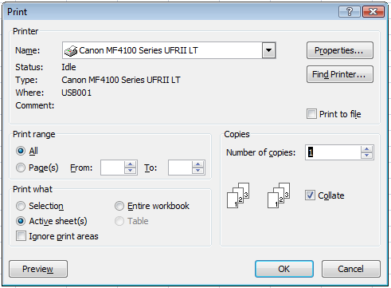
How to Print Spreadsheet Data (cont.)
To specify the pages that you want to print, in the Print dialog box, under Print range, in the From and To boxes, type the pages that you want to print.
Notes:
<number>

Slide 25
Questions
Notes:
<number>

